Slide 1


http://www.comp.nus.edu.sg/~cs2100/
Lecture #2b
Overview of C Programming

Slide 2
Questions?
IMPORTANT: DO NOT SCAN THE QR CODE IN THE VIDEO RECORDINGS. THEY NO LONGER WORK
Ask at
https://sets.netlify.app/module/676ca3a07d7f5ffc1741dc65
OR
Scan and ask your questions here! (May be obscured in some slides)

Slide 3
Preprocessor
Input
Compute
Output
5.3 Compute (1/10)
Computation is through function
So far, we have used one function: int main(void)
main() function: where execution of program begins
A function body has two parts
Declarations statements: tell compiler what type of memory cells needed
Executable statements: describe the processing on the memory cells
Python
int main(void) {
/* declaration statements */
/* executable statements */
return 0;
}
def main():
# statements
return 0
if __name__ == "__main__":
main()

Slide 4
Preprocessor
Input
Compute
Output
5.3 Compute (2/10)
Declaration Statements: To declare use of variables
int count, value;
Data type
Names of variables
User-defined Identifier
Name of a variable or function
May consist of letters (a-z, A-Z), digits (0-9) and underscores (_), but MUST NOT begin with a digit
Case sensitive, i.e. count and Count are two distinct identifiers
Guideline: Usually should begin with lowercase letter
Must not be reserved words (next slide)
Should avoid standard identifiers (next slide)
Eg: Valid identifiers: maxEntries, _X123, this_IS_a_long_name Invalid: 1Letter, double, return, joe’s, ice cream, T*S

Slide 5
Preprocessor
Input
Compute
Output
5.3 Compute (3/10)
Reserved words (or keywords)
Have special meaning in C
Eg: int, void, double, return
Complete list: http://c.ihypress.ca/reserved.html
Cannot be used for user-defined identifiers (names of variables or functions)
Standard identifiers
Names of common functions, such as printf, scanf
Avoid naming your variables/functions with the same name of built-in functions you intend to use

Slide 6
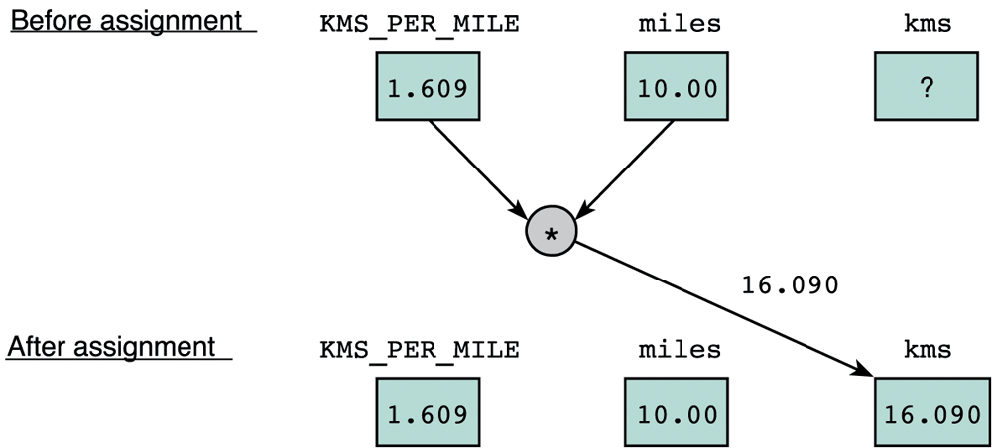
Preprocessor
Input
Compute
Output
5.3 Compute (4/10)
Executable statements
I/O statements (eg: printf, scanf)
Computational and assignment statements
Assignment statements
Store a value or a computational result in a variable
(Note: ‘=’ means ‘assign value on its right to the variable on its left’; it does NOT mean equality)
Left side of ‘=’ is called lvalue
Eg: kms = KMS_PER_MILE * miles;

Slide 7
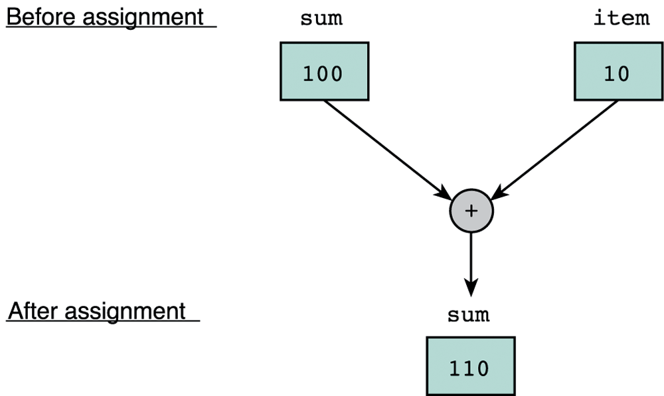
Preprocessor
Input
Compute
Output
5.3 Compute (5/10)
Eg: sum = sum + item;
Note: lvalue must be assignable
Examples of invalid assignment (result in compilation error “lvalue required as left operand of assignment”):
32 = a; // ‘32’ is not a variable
a + b = c; // ‘a + b’ is an expression, not variable
Assignment can be cascaded, with associativity from right to left:
a = b = c = 3 + 6; // 9 assigned to variables c, b and a
The above is equivalent to: a = (b = (c = 3 + 6));
which is also equivalent to:
c = 3 + 6; b = c;
a = b;
Python
Can write: a = b = c = 3 + 6
CANNOT: a = 5 + (b = 3)

Slide 8
Preprocessor
Input
Compute
Output
5.3 Compute (6/10)
Side effect:
An assignment statement does not just assigns, it also has the side effect of returning the value of its right-hand side expression
Hence a = 12; has the side effect of returning the value of 12, besides assigning 12 to a
Usually we don’t make use of its side effect, but sometimes we do, eg:
z = a = 12; // or: z = (a = 12);
The above makes use of the side effect of the assignment statement a = 12; (which returns 12) and assigns it to z
Side effects have their use, but avoid convoluted codes:
a = 5 + (b = 10); // assign 10 to b, and 15 to a
Side effects also apply to expressions involving other operators (eg: logical operators). We will see more of this later.

Slide 9
Preprocessor
Input
Compute
Output
5.3 Compute (7/10)
Arithmetic operations
Binary Operators: +, –, *, /, % (remainder)
Left Associative (from left to right)
46 / 15 / 2 → 3 / 2 → 1
19 % 7 % 3 → 5 % 3 → 2
Unary operators: +, –
Right Associative
x = – 23 p = +4 * 10
Execution from left to right, respecting parentheses rule, and then precedence rule, and then associative rule (slide 30)
addition, subtraction are lower in precedence than multiplication, division, and remainder
Truncate result if result can’t be stored (slide 31)
int n; n = 9 * 0.5; results in 4 being stored in n.

Slide 10
Preprocessor
Input
Compute
Output
5.3 Compute (8/10)
ArithOps.c
// To illustrate some arithmetic operations in C
#include <stdio.h>
int main(void) {
int x, p, n;
// to show left associativity
printf("46 / 15 / 2 = %d\n", 46/15/2);
printf("19 %% 7 %% 3 = %d\n", 19%7%3);
// to show right associativity
x = -23;
p = +4 * 10;
printf("x = %d\n", x);
printf("p = %d\n", p);
// to show truncation of value
n = 9 * 0.5;
printf("n = %d\n", n);
return 0;
}
$ gcc ArithOps.c –o ArithOps
$ ArithOps
46 / 15 / 2 = 1
19 % 7 % 3 = 2
x = -23
p = 40
n = 4

Slide 11
Preprocessor
Input
Compute
Output
5.3 Compute (9/10)
Arithmetic operators: Associativity & Precedence
Operator Type | Operator | Associativity
Primary expression operators | ( ) expr++ expr-- | Left to right
Unary operators | * & + - ++expr --expr (typecast) | Right to left
Binary operators | * / % | Left to right
 | + -
Assignment operators | = += -= *= /= %= | Right to left
Python
expr++, expr--, ++expr, --expr
are not available

Slide 12
Preprocessor
Input
Compute
Output
5.3 Compute (10/10)
Mixed-Type Arithmetic Operations
int m = 10/4; means
float p = 10/4; means
int n = 10/4.0; means
float q = 10/4.0; means
int r = -10/4.0; means
m = 2;
p = 2.0;
n = 2;
q = 2.5;
r = -2;
Caution!
Type Casting
Use a cast operator to change the type of an expression
syntax: (type) expression
int aa = 6; float ff = 15.8;
float pp = (float) aa / 4; means
int nn = (int) ff / aa; means
float qq = (float) (aa / 4); means
pp = 1.5;
nn = 2;
qq = 1.0;
Try out TypeCast.c

Slide 13
5.3 Compute: Difference with Python
Python Floor Division
a = 10/4 means
b = 10//4 means
c = -10/4 means
d = -10//4 means
a = 2.5
b = 2
c = -2.5
d = -3
Modulo
Python % is modulo
a = 10%4 →
b = -10%4 →
C % is remainder
a = 10%4 →
b = -10%4 →
NOTE: be careful with negative values for % operation
a = 2
b = 2
a = 2
b = -2
Try out Modulo.c and compare with Modulo.py

Slide 14
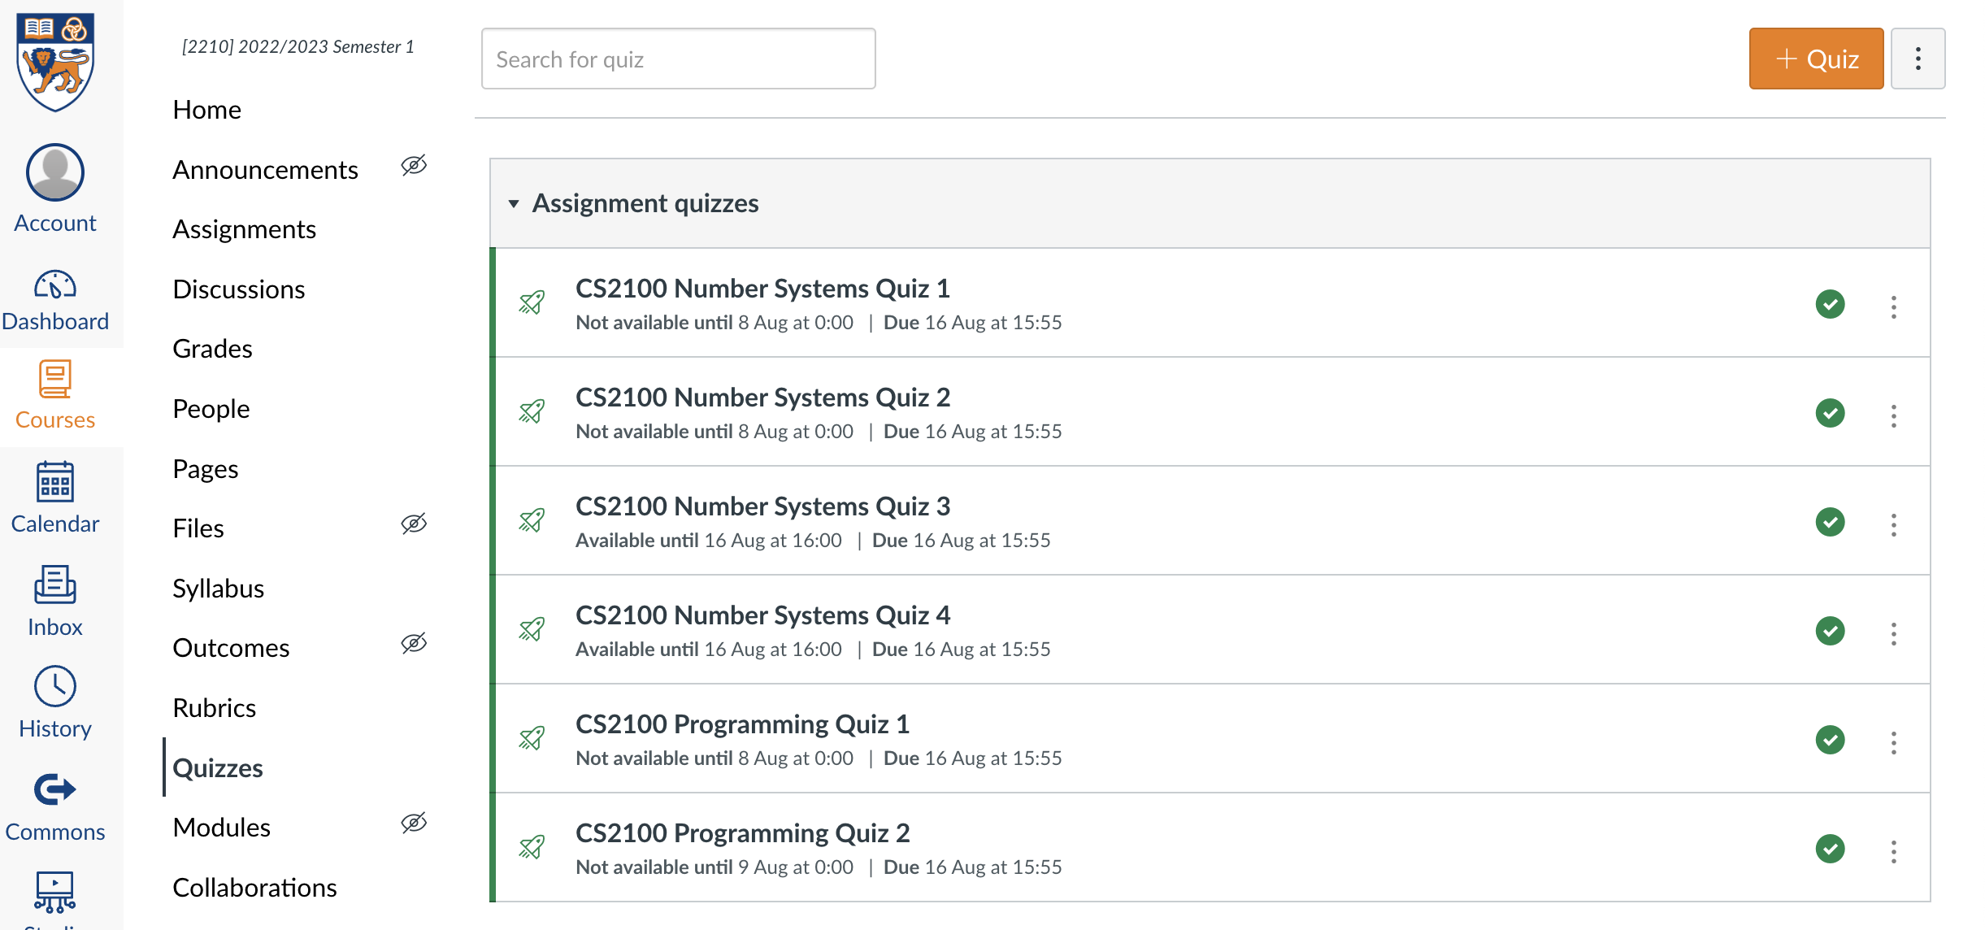
Quiz
Please complete the “CS2100 C Programming Quiz 1” in Canvas.
Access via the “Quizzes” tool in the left toolbar and select the quiz on the right side of the screen.

Slide 15
End of File

